Slide 1
Prescaler and generating a large time delay

Slide 2
The time delay(t) depends on crystal frequency (f) and value in timer’s 16 bit register(r).
The time delay is inversely proportional to both crystal frequency and the value in timer’s 16 bit register.
i.e. t ∝ 1/f and t ∝ 1/r

Slide 3
We have seen that the maximum delay generated for the crystal frequency 10 MHz without prescaler is 26.2144 ms.
If we want to generate more delay, then we should use prescaler

Slide 4
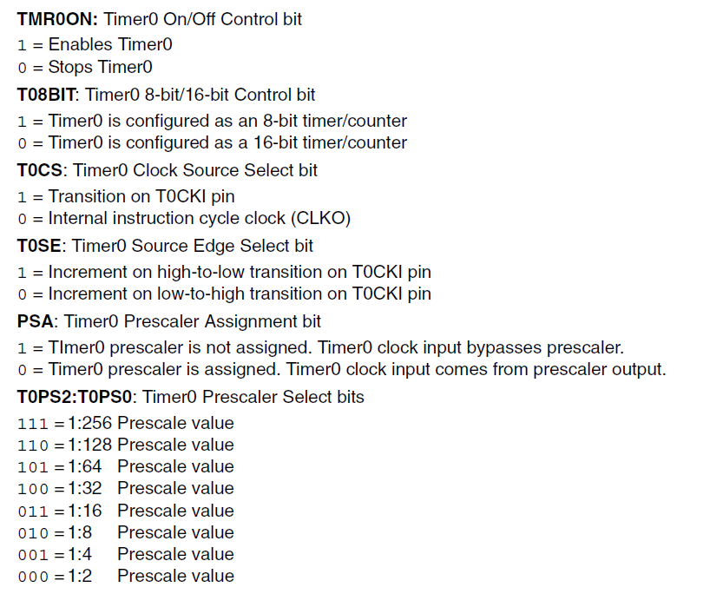

Slide 5
Find the timer’s clock frequency and its period for PIC18, with crystal frequency 16 MHz. Assume that a prescaler of 1:64 is used.
Crystal frequency = 16 MHz
Microcontroller frequency = 16/4 = 4 MHz.
Frequency due to prescaler = 4/64 = 0.0625 MHz= 62500 Hz.
Timer’s period = 1/62500 = 16 µs

Slide 6
Find the delay (in seconds) generated by the following program. Exclude the overhead due to the instructions in the loop. Assume XTAL = 10 MHz

Slide 7
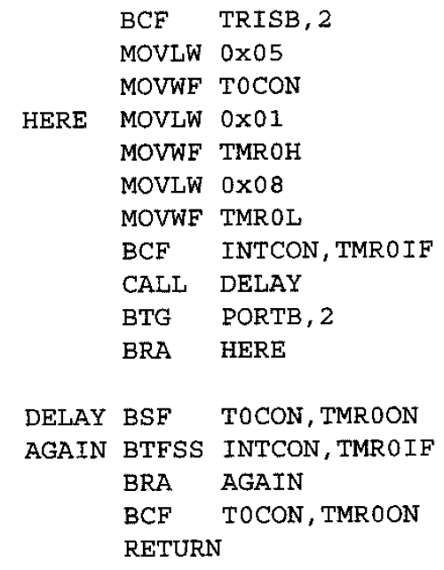

Slide 8
T0CON = 0x05

Slide 9
T0CON = 0x05
0 0 0 0 0 1 0 1
Counter 16 bit transition increment Prescaler 1:64 prescale
timer off on cycle on +ve assigned
clock edge

Slide 10
T0CON = 0x05
0 0 0 0 0 1 0 1
Counter 16 bit transition increment Prescaler 1:64 prescale
timer off on cycle on +ve assigned
clock edge
Timer frequency = 10/4/64 = 390625 Hz
Timer cycle = 1/390625 = 25.6 µs
Count = FFFFH – 0108H+1 = FEF8H = 65272
Time delay = 65272 * 25.6 µs = 1.671 s

Slide 11
What is the maximum time delay that can be generated using timer 0, with prescaler. Assume XTAL = 10 MHz.

Slide 12
What is the maximum time delay that can be generated using timer 0, with prescaler. Assume XTAL = 10 MHz.
Timer frequency = 10/4/256 = 9765.625 Hz
Time cycle = 1/9765.625 = 102.4 µs
Count = FFFFH – 0000H+1 = 10000H = 65536
Time delay = 65536 * 102.4 µs = 6.710886 s

Slide 13
Write a program to generate a square wave of 50 Hz frequency on pin PORTB.7. Use Timer0, 16-bit mode, with prescaler = 128

Slide 14
Counter 16 bit transition increment Prescaler
timer off on cycle clock on +ve edge not assigned
low to high
0 0 0 0 0 1 1 0

Slide 15
Counter 16 bit transition increment Prescaler
timer off on cycle clock on +ve edge not assigned
low to high
0 0 0 0 0 1 1 0
T0CON = 06H

Slide 16
Given :
Frequency of square wave = 50 Hz.
Full cycle delay = 1/50 = 0.02 s = 20 ms.
Half cycle delay = 10 ms.
t= 10 ms = 10000 µs
f= 10 MHz

Slide 17
n = t*f /4/128 = 10000*10/4/128 = 195.3125 = 195
c= 65536 – n = 65536 – 195 = 65341
Convert c to Hex = FF3DH
Set TMR0H = FFH and TMR0L = 3DH

Slide 18
BCF TRISB, 7
MOVLW 0x06
MOVWF T0CON
L1 MOVLW 0xFF
MOVWF TMR0H
MOVLW 0x3D
MOVWF TMR0L
BCF INTCON, TMR0IF
BTG PORTB, 7
BSF T0CON, TMR0ON
L2 BTFSS INTCON, TMR0IF
BRA L2
BCF T0CON, TMR0ON
BRA L1

Slide 19
8 bit Timer programming
TMR0L – 00H to FFH
Start the timer0
Set the timer on bit
BSF T0CON, TMR0ON or BSF T0CON,7
It starts to count up till FFH then back to 00H.
When it reaches FFH, timer interrupt flag (TMR0IF ) of interrupt control register (INTCON) is set.
In order to repeat the process, load the TMR0L registers with the original value and reset TMR0IF.

Slide 20
Timer frequency = f = crystal frequency/4 (/ prescale if applicable)
Each clock period = t = 1/f
Time delay= number of counts * clock period
Number of counts = c = FFH – (value in TMR0L) +1(rolling back) (in decimal)
Time delay(half cycle) = c * t
Time delay(full cycle) = 2 * c * t

Slide 21
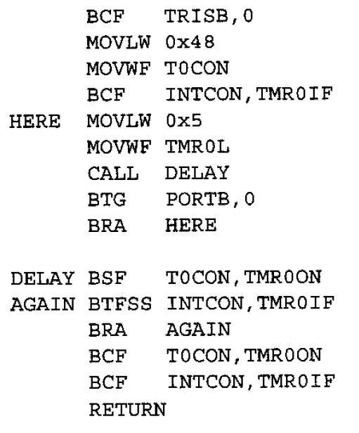
Assuming that XTAL = 10 MHz, find the frequency of the square wave generated on pin PORTB.0 in the following program

Slide 22
Assuming that XTAL = 10 MHz, find the frequency of the square wave generated on pin PORTB.0 in the following program
Timer frequency = f = 10/4 = 2.5 MHz

Slide 23
Assuming that XTAL = 10 MHz, find the frequency of the square wave generated on pin PORTB.0 in the following program
Timer frequency = f = 10/4 = 2.5 MHz
Each clock period = t = 1/f = 1/2.5 = 0.4 µs

Slide 24
Assuming that XTAL = 10 MHz, find the frequency of the square wave generated on pin PORTB.0 in the following program
Timer frequency = f = 10/4 = 2.5 MHz
Each clock period = t = 1/f = 1/2.5 = 0.4 µs
Time delay= number of counts * clock period

Slide 25
Assuming that XTAL = 10 MHz, find the frequency of the square wave generated on pin PORTB.0 in the following program
Timer frequency = f = 10/4 = 2.5 MHz
Each clock period = t = 1/f = 1/2.5 = 0.4 µs
Time delay= number of counts * clock period
Number of counts = c = FFH – 5 +1 = FBH = 251

Slide 26
Assuming that XTAL = 10 MHz, find the frequency of the square wave generated on pin PORTB.0 in the following program
Timer frequency = f = 10/4 = 2.5 MHz
Each clock period = t = 1/f = 1/2.5 = 0.4 µs
Time delay= number of counts * clock period
Number of counts = c = FFH – 5 +1 = FBH = 251
Time delay(half cycle) = 251*0.4 = 100.4 µs

Slide 27
Assuming that XTAL = 10 MHz, find the frequency of the square wave generated on pin PORTB.0 in the following program
Timer frequency = f = 10/4 = 2.5 MHz
Each clock period = t = 1/f = 1/2.5 = 0.4 µs
Time delay= number of counts * clock period
Number of counts = c = FFH – 5 +1 = FBH = 251
Time delay(half cycle) = 251*0.4 = 100.4 µs
Time delay(full cycle) = 200.8 µs

Slide 28
Assuming that XTAL = 10 MHz, find the frequency of the square wave generated on pin PORTB.0 in the following program
Timer frequency = f = 10/4 = 2.5 MHz
Each clock period = t = 1/f = 1/2.5 = 0.4 µs
Time delay= number of counts * clock period
Number of counts = c = FFH – 5 +1 = FBH = 251
Time delay(half cycle) = 251*0.4 = 100.4 µs
Time delay(full cycle) = 200.8 µs
Frequency of square wave = 1/200.8 = 4980.78 Hz = 4.980 KHz

Slide 29
What is the possible minimum frequency of the square wave generated using 8 bit timer0 and prescaler 256.

Slide 30
What is the possible minimum frequency of the square wave generated using 8 bit timer0 and prescaler 256. Assume XTAL = 10 MHz
Timer frequency = f = 10/4 = 2.5 MHz
Each clock period = t = 1/f/prescaler = 1/2.5/256 = 1.5625 ms
Time delay= number of counts * clock period
Number of counts = c = FFH – 0 +1 = 100H = 256
Time delay(half cycle) = 256*1.5625 = 400 ms
Time delay(full cycle) = 800 ms
Frequency of square wave = 1/800 = 1.25 Hz

